Slide 1
Dependents Exemptions
Pub 17 – Chapter 3
Pub 4012 – Tab C
(1040-lines 6c & 6d)
NJ 1040
Notes:
1

Slide 2
Dependent Exemptions
Definition: Dependent other than taxpayer/spouse who entitles taxpayer to exemption
Dependent must be either
Qualifying child - OR
Qualifying relative
Notes:
2
A dependent exemption is an exemption taken for someone else
A “Qualifying child” is not necessarily a child (e.g. - disabled 40 year old dependent)
A “Qualifying relative” is not necessarily a relative (e.g. low-in come non-relative living with Taxpayer)

Slide 3
Dependent Exemptions Types
Exemption Type | Federal Exemption | NJ Exemption
Dependents: Qualifying child Qualifying relative | Yes | Yes
College Student | Exemption only if college student is a dependent & under 24 | Same exemption as Federal if under 24, plus extra exemption if under 22 (see rules)
NJ generally follows Federal rules for dependent exemptions, with a few additions

Slide 4
Useful Tools For Dependent Exemptions Validation
 | Tool
Rules for Exemption for a Dependent or Qualifying Relative | Pub 4012 Tab C, also available in laminated Resource Tool for Tax Counselors
 | Via TaxPrep4Free.org link: Use automated tool available on IRS.gov called Interactive Tax Assistant “ITA”
 | Via TaxPrep4Free.org link: Use automated tool available on Preparer page, right column Qualifying Child/Qualifying Relative Flowchart Tool Use automated tool available on Preparer page, right column Dependent Calculator
Notes:
DO NOT try to figure out dependency without using reference tools. Rules are very complex

Slide 5
Federal Dependency Rules
Pub 4012 Tab C, Pub 17
Six tests to determine if someone is a dependent
Age
Relationship
Citizen/Resident
Gross Income
Support
Residency
Notes:
5

Slide 6
Dependency Age Test
Pub 4012 Tab C, Pub 17
To be a Qualifying Child
Age younger than taxpayer(or spouse if MFJ)
Age <19 (or <24 if full time student)
Any age if disabled
To be a Qualifying Relative
No age requirement
Notes:
A qualifying relative does not have to be an actual relative, as long as he/she lived with taxpayer all year as a member of household
6

Slide 7
Dependency Relationship Test
Pub 4012 Tab C, Pub 17
To be a Qualifying Child
Son, daughter, step or foster child, brother, sister, grandchild, niece or nephew
Aunts, uncles & cousins do not qualify
To be a Qualifying Relative
Same as Qualifying Child + father, mother, grandparents, uncle/aunt, all in-laws (not cousins) or any other person who lived with you all year as a member of your household (including cousins)
Notes:
7

Slide 8
Dependency Citizen/Resident & Gross Income Tests
Pub 4012 Tab C, Pub 17
Citizen/Resident Test:
To be a Qualifying Child or Qualifying Relative
Must be US citizen or resident of US, Canada or Mexico
Gross Income Test:
To be a Qualifying Child
Any income
To be a Qualifying Relative
Gross Income < $3,950
Note: Gross Income as defined for this test does not include tax-exempt income
Notes:
Exception to citizenship rule is if child is adopted from a foreign country
8

Slide 9
Dependency Support Test
Pub 4012 Tab C, Pub 17
To be a Qualifying Child
Child must not provide > 50% of own support
To be a Qualifying Relative
Taxpayer must provide > 50% of person’s support
Notes:
9

Slide 10
What Is Support?
Pub 17, Chapter 3
Dependent portion of household expenses (includes rent, food, utilities, repairs)
and
Dependent portion of personal expenses (includes clothing, education, medical, travel)
50% is the magic number
Taxpayer usually knows
Notes:
10
An individual’s own funds are not considered support unless they spend it for support
E.g. - A person receives SS , but saves it
Scholarship received by a full-time student is not considered when determining support
A student loan taken under the student’s own name is considered part of support

Slide 11
Dependency Residency Tests
Pub 4012 tab C, Pub 17
To be a Qualifying Child
Child must live with taxpayer > ½ year
To be a Qualifying Relative
Actual relative
Does not have to live with taxpayer
Any other non-relative
Must live with taxpayer all year
Note: Absences due to school, illness or vacation are considered temporary
Notes:
11

Slide 12
Dependency Criteria Comparison Between QC & QR
Qualifying Child (QC)
Age: Younger than TP & age<19 (<24 if student) OR disabled any age
Relationship: see list of relatives
Gross Income: any income
Support: Child must not provide > 50%
Residency: Must live with TP > ½ year
Qualifying Relative (QR)
Age: Any age
Relationship: adds parents, grandparents, uncle/aunts, in-laws & non-relatives who live with TP
Gross Income < $3,900
Support - TP must provide > 50%
Residency:
Relatives - Do not have to live with TP
Any other - Must live with TP all year
Notes:
12

Slide 13
Federal Dependency Rules Exceptions
Cannot be a qualifying relative if the person is qualifying child of taxpayer or anyone else
Separate rules apply for
Dependency of married persons filing joint returns (Pub 17, Chapter 3)
Dependency exemption for qualifying relative (Pub 4012, Page C-7)
Dependency of children of divorced or separated parents or parents who live apart (Pub 4012, Page C-8)
Notes:
Rules for dependency of children of divorced or separated parents are important – check Pub 4012
13

Slide 14
Qualifying Child Of Non-Custodial Parent
Parents are divorced, legally separated or lived apart for the last 6 months
Child received more than 50% support from the parents
Child was in custody of one or both parents for more than half the year
Decree or signed agreement by custodial parent provides that the non-custodial parent can claim exemption (paper Form 8332 is required; must be mailed in)
Notes:
14

Slide 15
TW -Main Information Screen Entering Data on Dependents
Answer questions relating to whether you can be claimed on another return
Dependent /Non Dependent :
Names
SS #s
Birth Dates
Relationship to taxpayer (Drop down menu)
Months in home (Drop down menu) *
Dependent/Non dependent code (Drop down menu)
Check Dependent Care (DC), if applicable
Check EIC
TW checks CTC , if applicable
*Note: Months in home for newborn, adopted child (in year adopted), and deceased dependents is 12 months

Slide 16
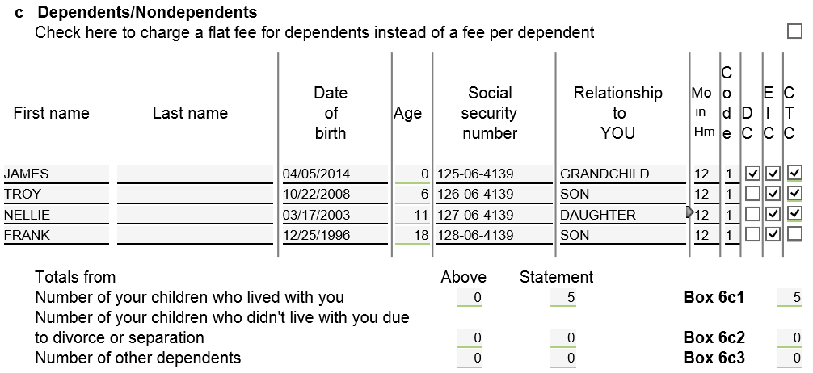
TW Main Information Screen Enter Dependents/Non-Dependents
List individuals who lived with Taxpayer. Include Dependents and
Non-dependents (could qualify for EIC, DTC, CTC). List children in
age order, from youngest to oldest
Notes:
There is only space for 4 dependents on Main Info screen. Must enter rest of dependent info on Additional Dependents screen (see next slide)
Drop down menus for Relationship to You, Months in Home, and Code boxes
Code box used to indicate dependency status
Months in Home box used to indicate how long person lived with taxpayer during tax year
Check DC box if you incurred dependent care expenses during year
Check Earned Income Credit (EIC) box for every dependent. TW will determine if child is eligible based on answers to questions later
TaxWise automatically determines if child is eligible for Child Tax Credit (CTC) and checks CTC box as appropriate. Counselor does nothing
16

Slide 17
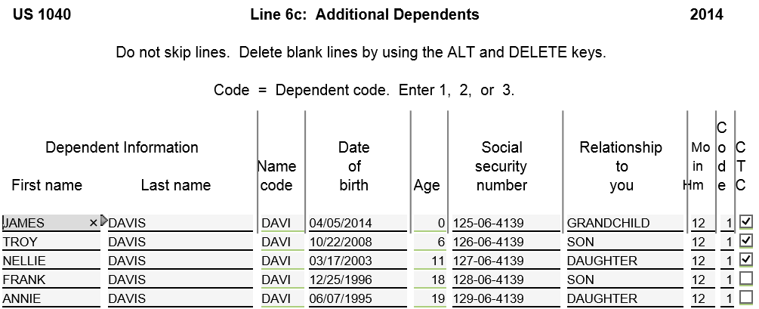
TW Additional Dependents Screen For More than 4 Dependents
To get to Additional Dependents Screen….Go to 1040 Page 1 & link from
any field in dependents section to Addl. Deps Wkt. Enter info for
Dependents over 4
TW populates 1st 4 dependents from Main Info
Notes:
If taxpayer has more than 4 dependents:
Enter first 4 dependents on Main Info screen, starting with the youngest
Nondependents & children who are qualifying children for EIC must be entered on Main Info screen in order to process correctly
Go to 1040 Page 1 (not Main Info screen) & link from any field in dependents section to Addl. Deps Worksheet screen
TW transfers info for first 4 dependents from Main Info screen
List info for remaining dependents
IMPORTANT: Once Additional Dependents form is created, changes to dependent info on Main Info screen do not flow through to Additional Dependents form
Make same change twice – once on Main Info screen & once on Additional Dependents screen
If dependent line is not complete on Main Info screen (e.g. – a field is not completed), that dependent will not transfer to Additional Dependents screen
17

Slide 18
Federal/State Differences: Exemptions for College Students
ITEM | FEDERAL | STATE | COUNSELOR ACTION
Depen-dent full-time college student | Parent can claim as dependent if < 24 | Parent can claim exemp-tion if depend- ent on Federal Parent can claim extra ex- emption if < 22* | Enter depen-dent code on Main Info screen Enter # of students < 22 on NJ1040 p. 2 Line 11
* Student must attend college full-time for some part of 5 calendar months; parent must pay at least ½ of tuition/ maintenance
Notes:
Requirement that student must spend at least some part of each of 5 calendar months of tax year in school can be a problem during student’s first or last year in college

Slide 19
TW Dependent F/T College Student – Additional Dependents Screen Parent’s Federal 1040
Notes:
On Federal return, parents can claim college student < 24 as dependent

Slide 20
Manual Adjustments on Dependent Exemptions -NJ 1040 Page 2
Most TW dependent exemption boxes on NJ 1040 are populated based on Main Information
Manual adjustments (check box) for :
Extra exemption for dependents attending college (Line 11)
Exemption for dependent domestic partner (Line 6)

Slide 21
TW Dependent F/T College Student < 22 Parent’s NJ 1040 Page 2
From Federal Additional Dependents screen
Enter # of extra exemptions for college students < 22
Notes:
On NJ return, parents claim exemption for college student if claimed on Federal
Can also claim 2 extra exemptions on NJ for 2 full-time college students < 22

Slide 22
NJ Exemption: Domestic Partner
NJ 1040 Page 3
Not recognized on Federal 1040
Additional NJ Exemption for dependent Domestic Partner
Domestic Partner is different than Civil Union Partner Filing Status
Requires affidavit and then registration
Same-sex and opposite-sex couples
Grants couples basic rights,
i.e. - the right to make health care decisions and to receive tax exemptions
At least age 62 (After 2/2007). Younger couples if Domestic Partnership formed before revised law 2/2007
Notes:
Additional Exemption ($1000)

Slide 23
TW Exemption for Domestic Partner NJ 1040 Page 2
To claim $1,000 extra exemption for Domestic Partner who is not filing own NJ return

Slide 24
TW- Additional Dependent Information For NJ 1040 Page 3
After completing Main Information screen for Dependents, update NJ 1040 page 2 Line 13 dependents for :
NJ Health Insurance boxes for dependents
Link to NJ Dependents Worksheet to check health insurance boxes if applicable
Persons living with taxpayer, but coded as non dependent on Main Info (Code 0) will not flow through to NJ 1040 and will need to be added
Must be done after Federal return is complete and TW calculates and validates NJ Earned Income Tax Credit (EITC) (procedure covered in later module)
Notes:
TW Glitch: TW only allows added additional dependents on the NJ Additional Dep Worksheet via the override function

Slide 25
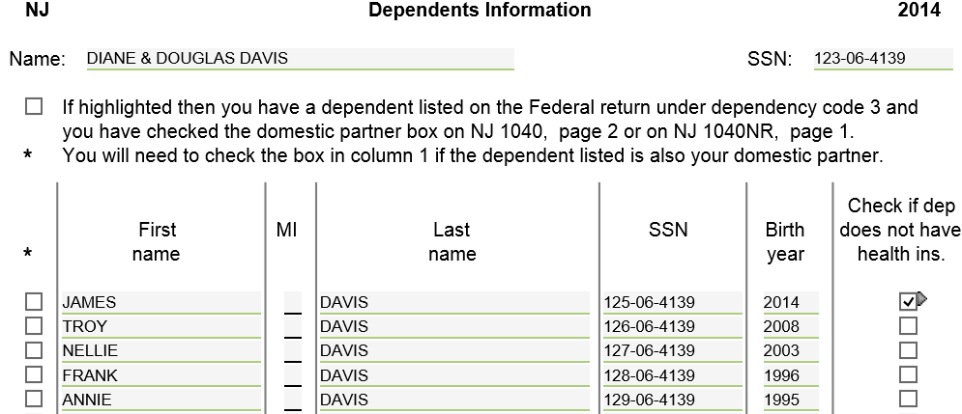
TW Dependent Health Insurance Info – NJ Dependents Worksheet
Link to NJ Dependents Worksheet from NJ 1040 Dependents section,
TW checks health insurance box on NJ 1040 Dependents Section
Notes:
Link to NJ Dependents Worksheet from NJ 1040 Dependents section to check if dependent does not have health insurance
TW checks health insurance box on NJ 1040 Page 2 Dependents section
This data is collected and used for gathering statistics and getting grants (not tax related). It is also used to try to get dependents enrolled in state health programs if eligible

